Slide 1


Bike store
Database analysis using sql server

Slide 2

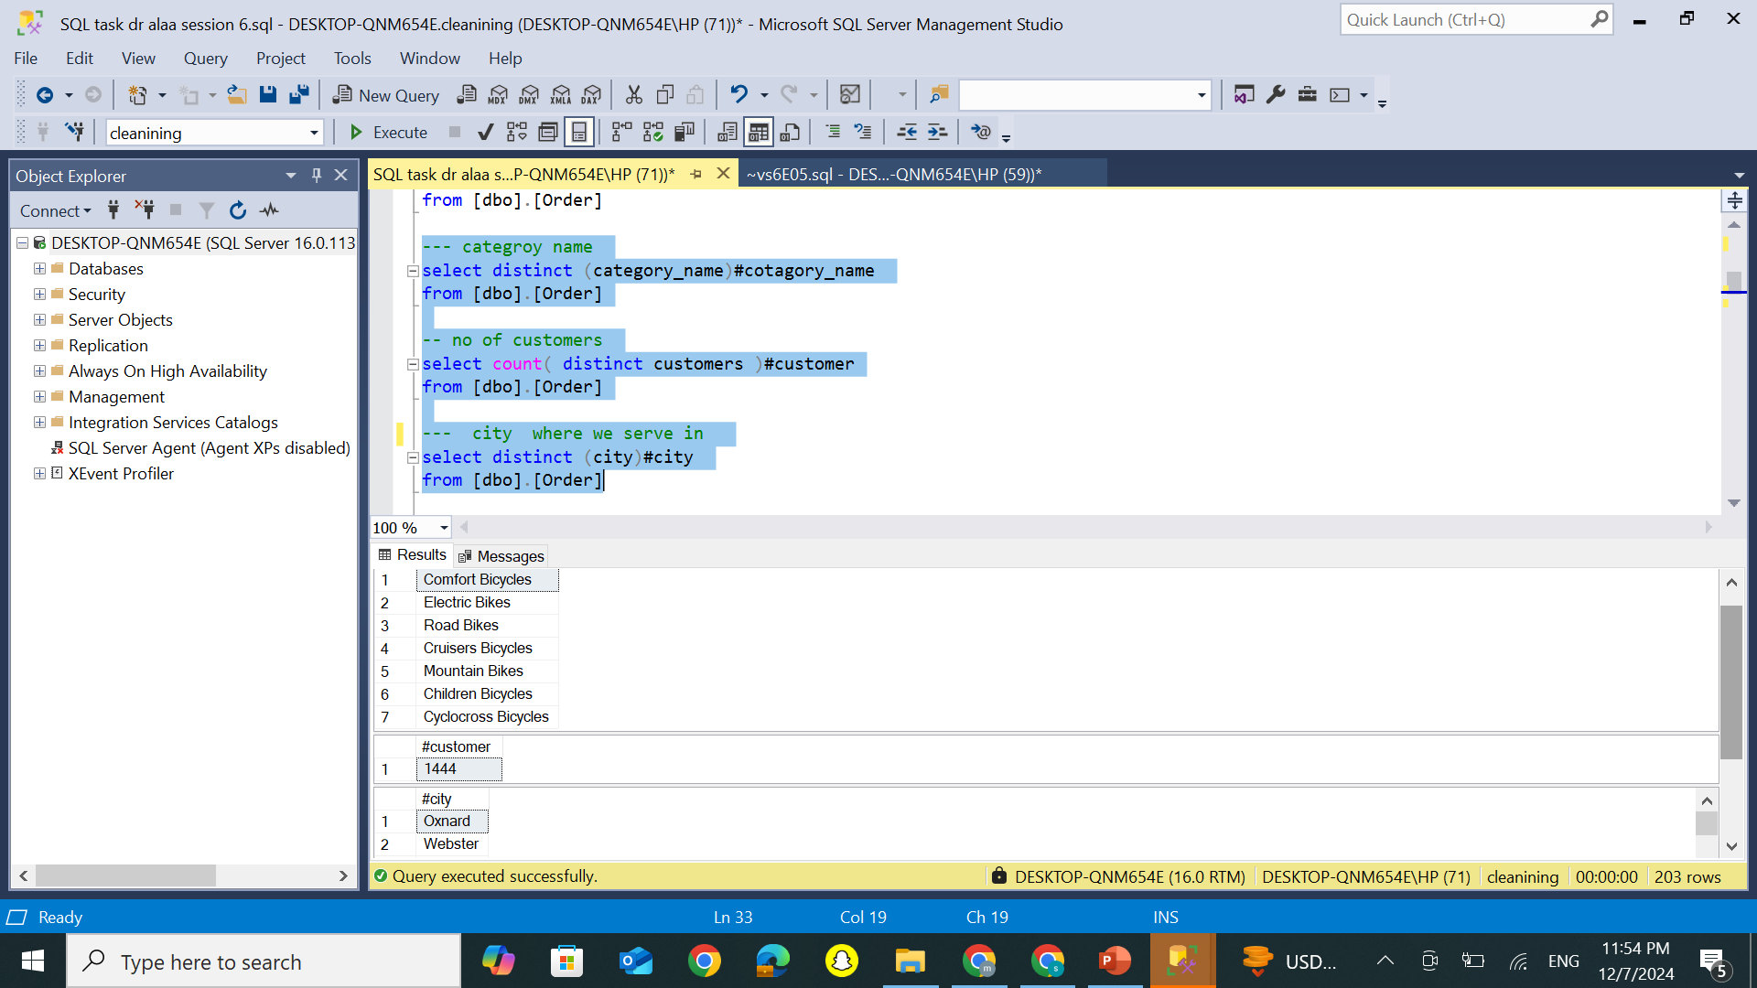
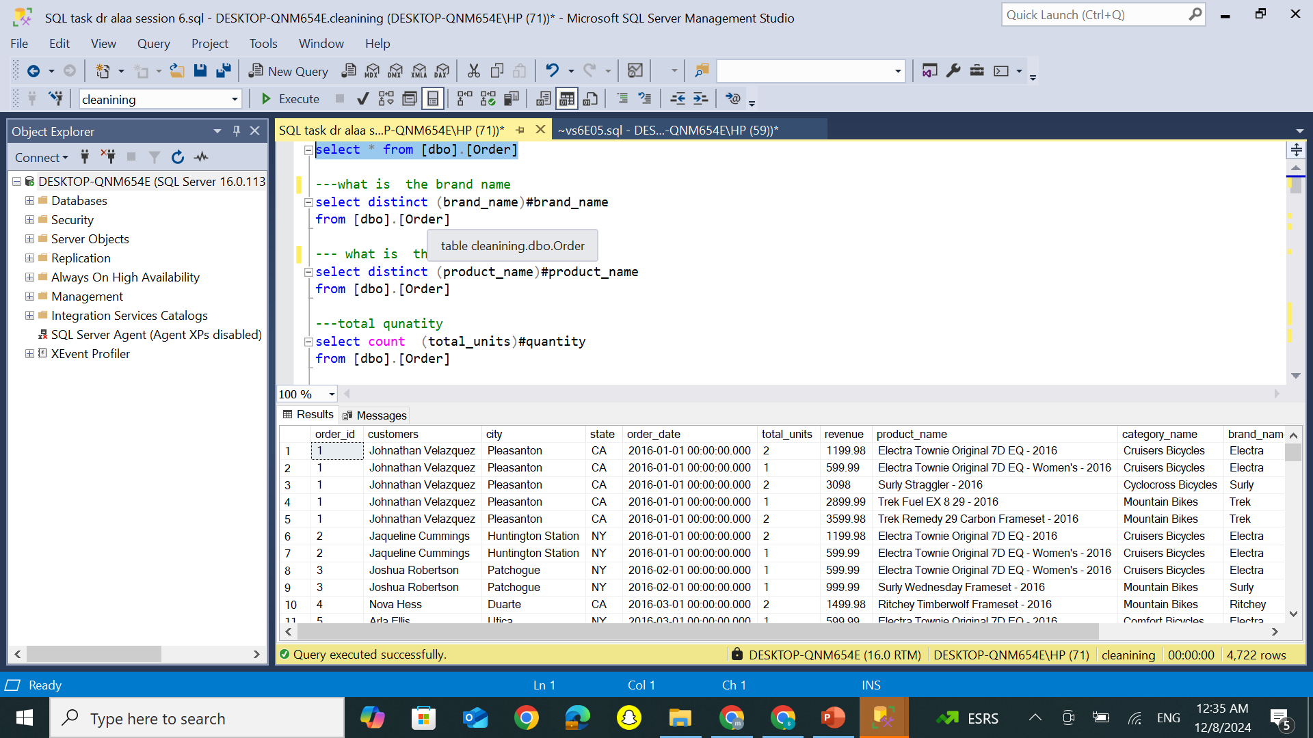
Overview : category, Customers, and Sales Locations
Explore data

Slide 3
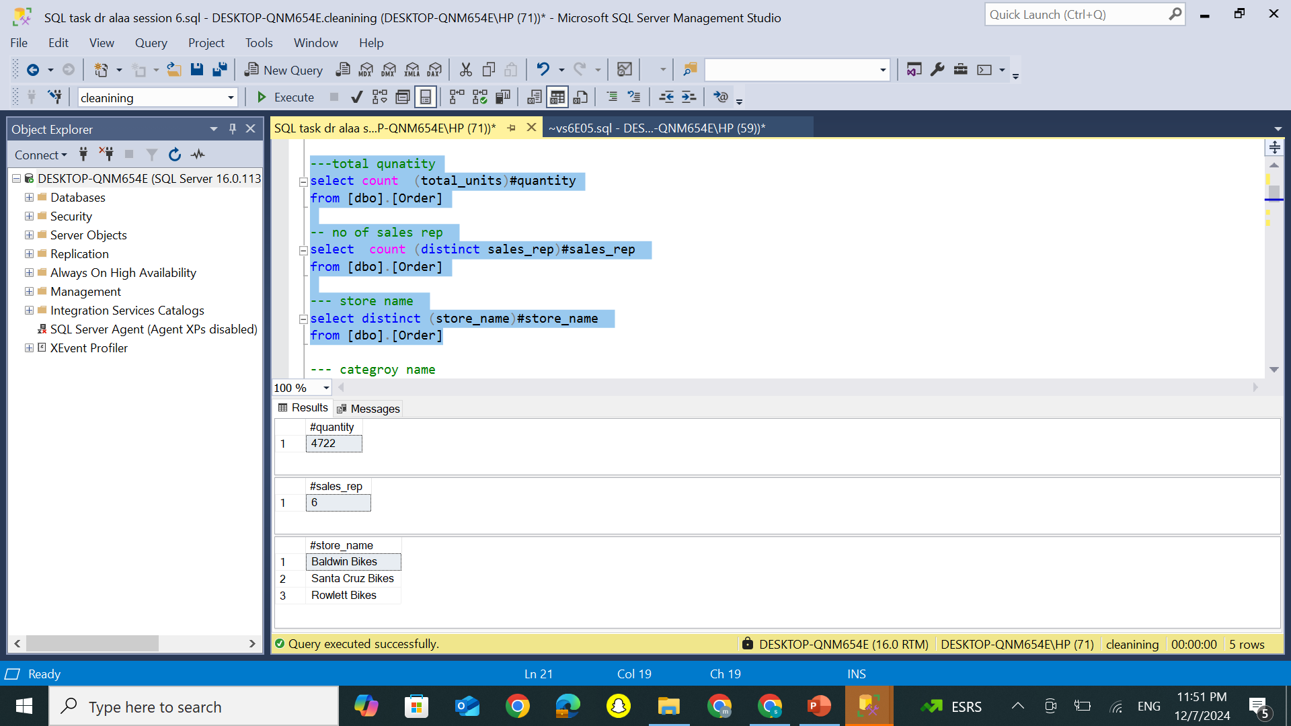
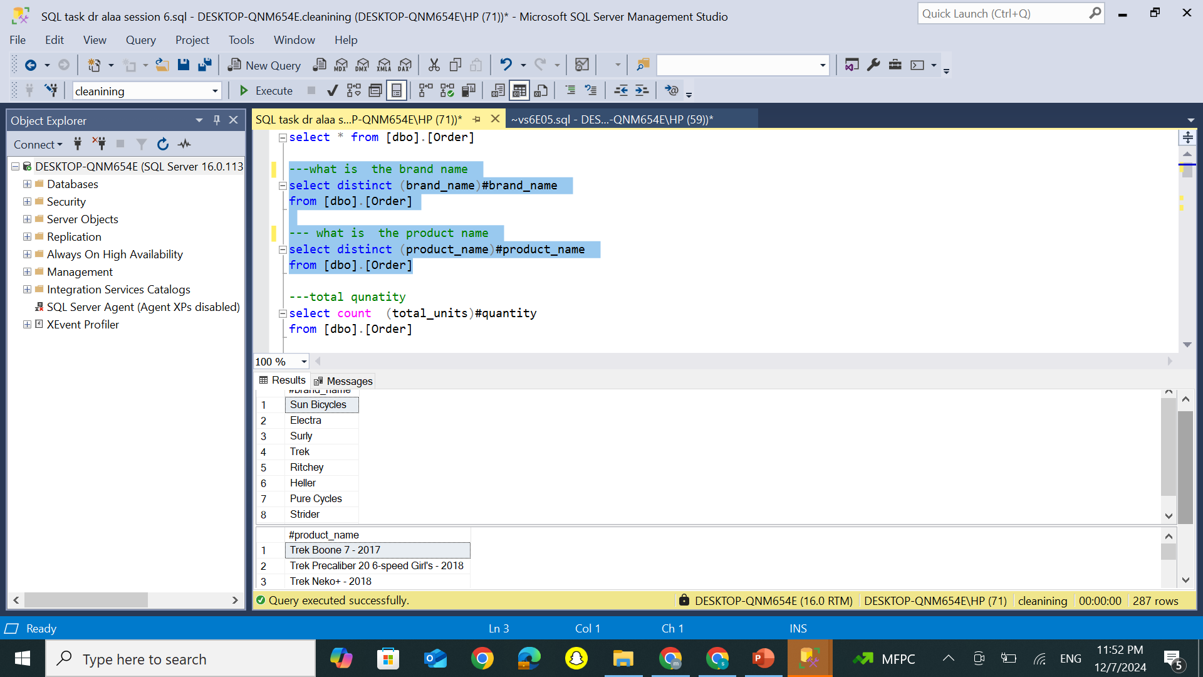
Analyzing Products, Brands, and Sales rep Performance, Quantities

Slide 4
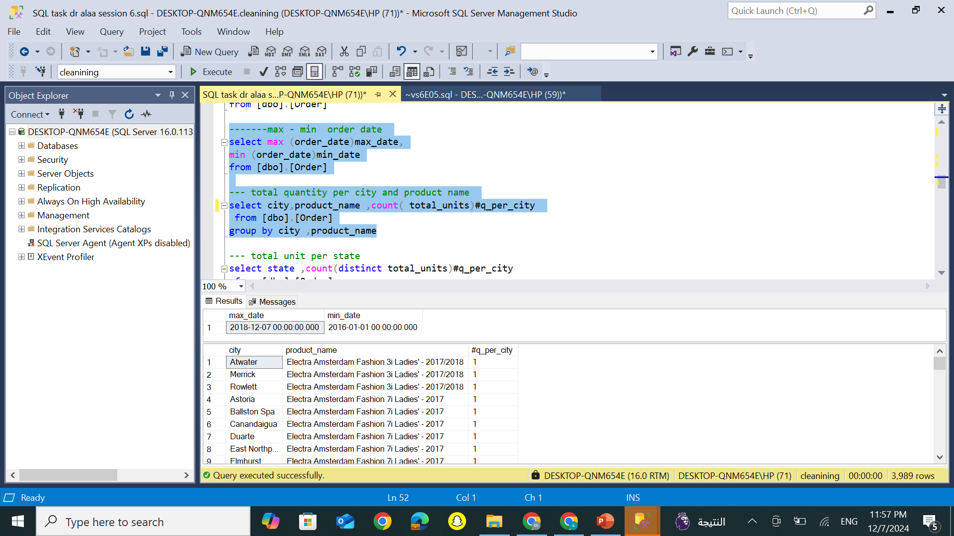
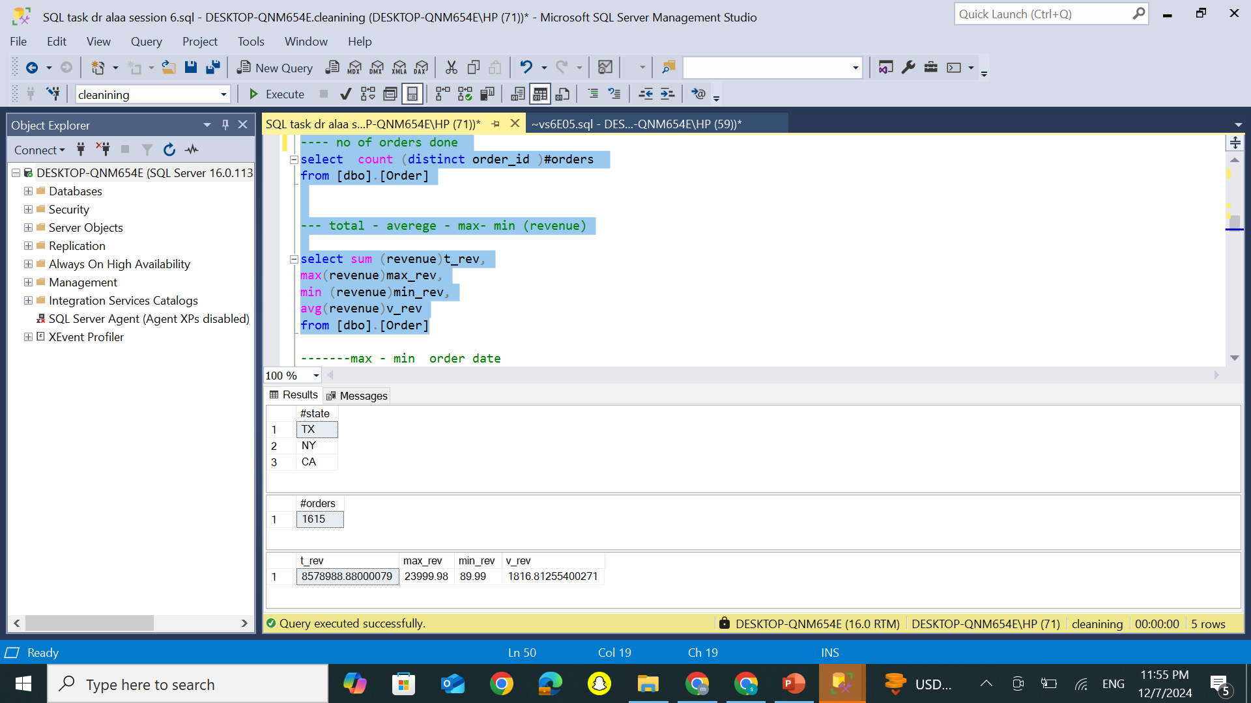
Detailed Insights : Max, Min, and Average revenue and quantity sold in each city

Slide 5
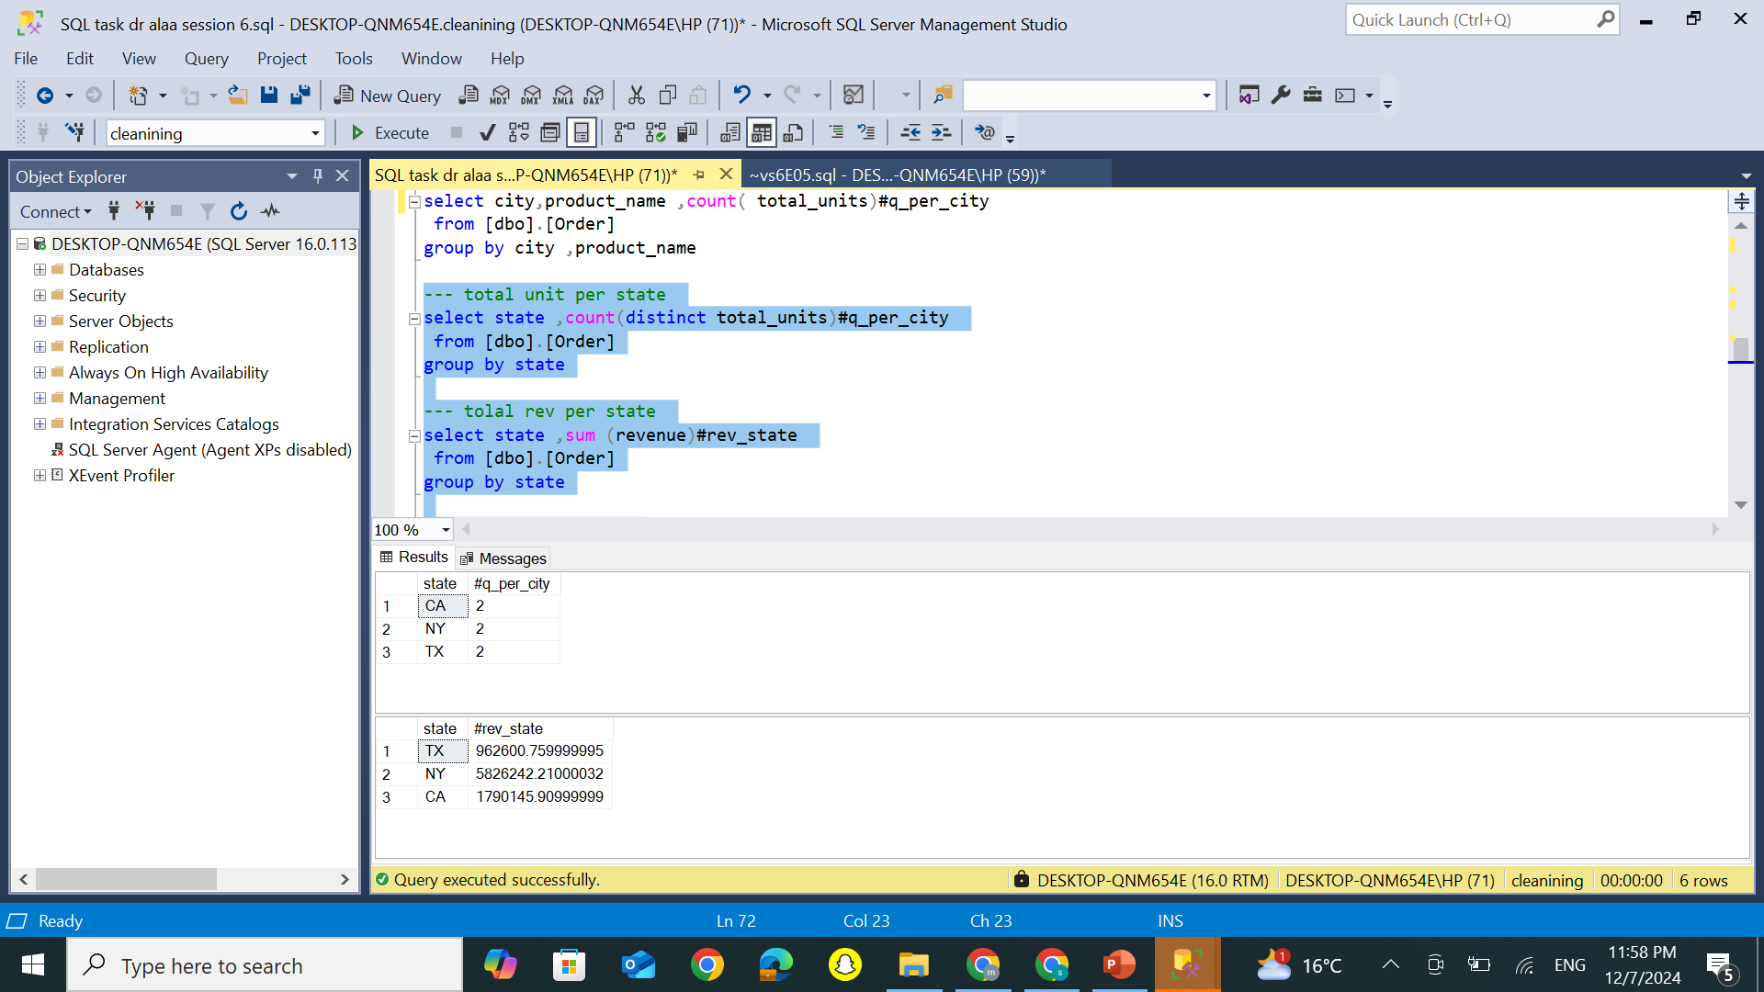
Detailed Overview: Max/Min Dates, Sales, and Profits by State

Slide 6
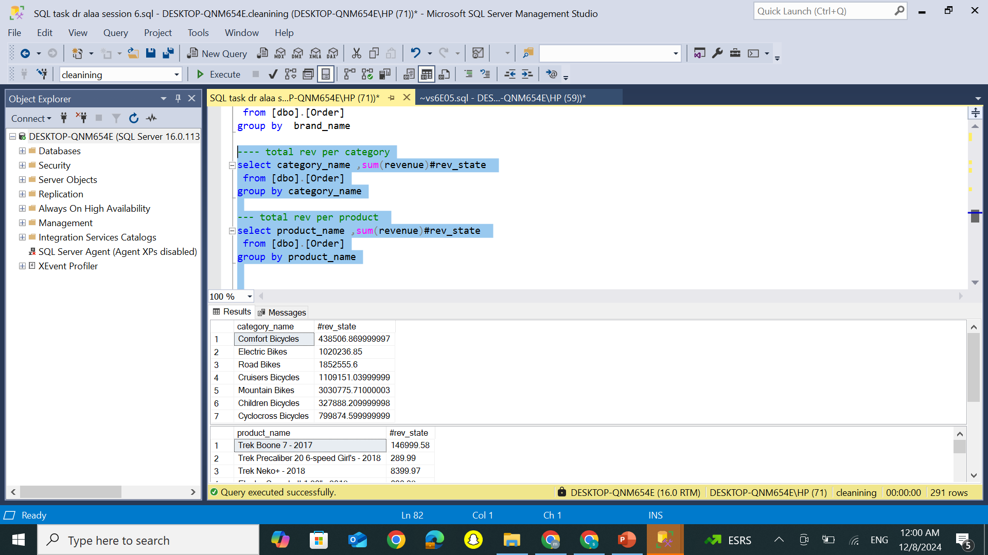
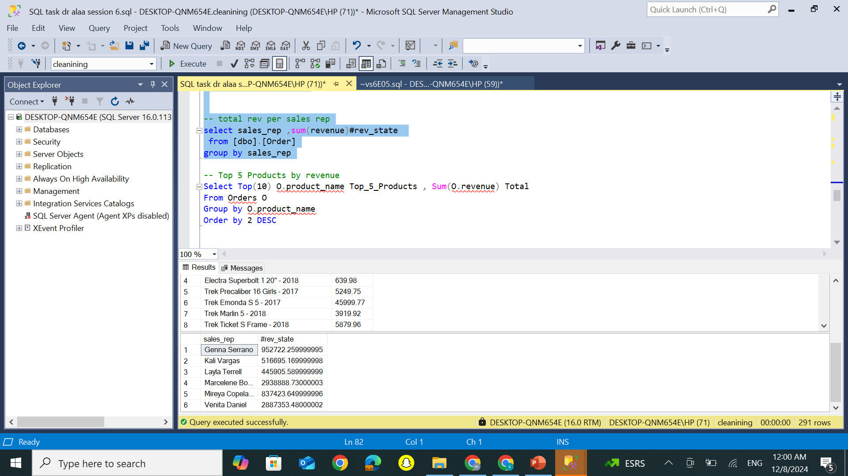
Profit Distribution Across Sellers, Products, and category

Slide 7
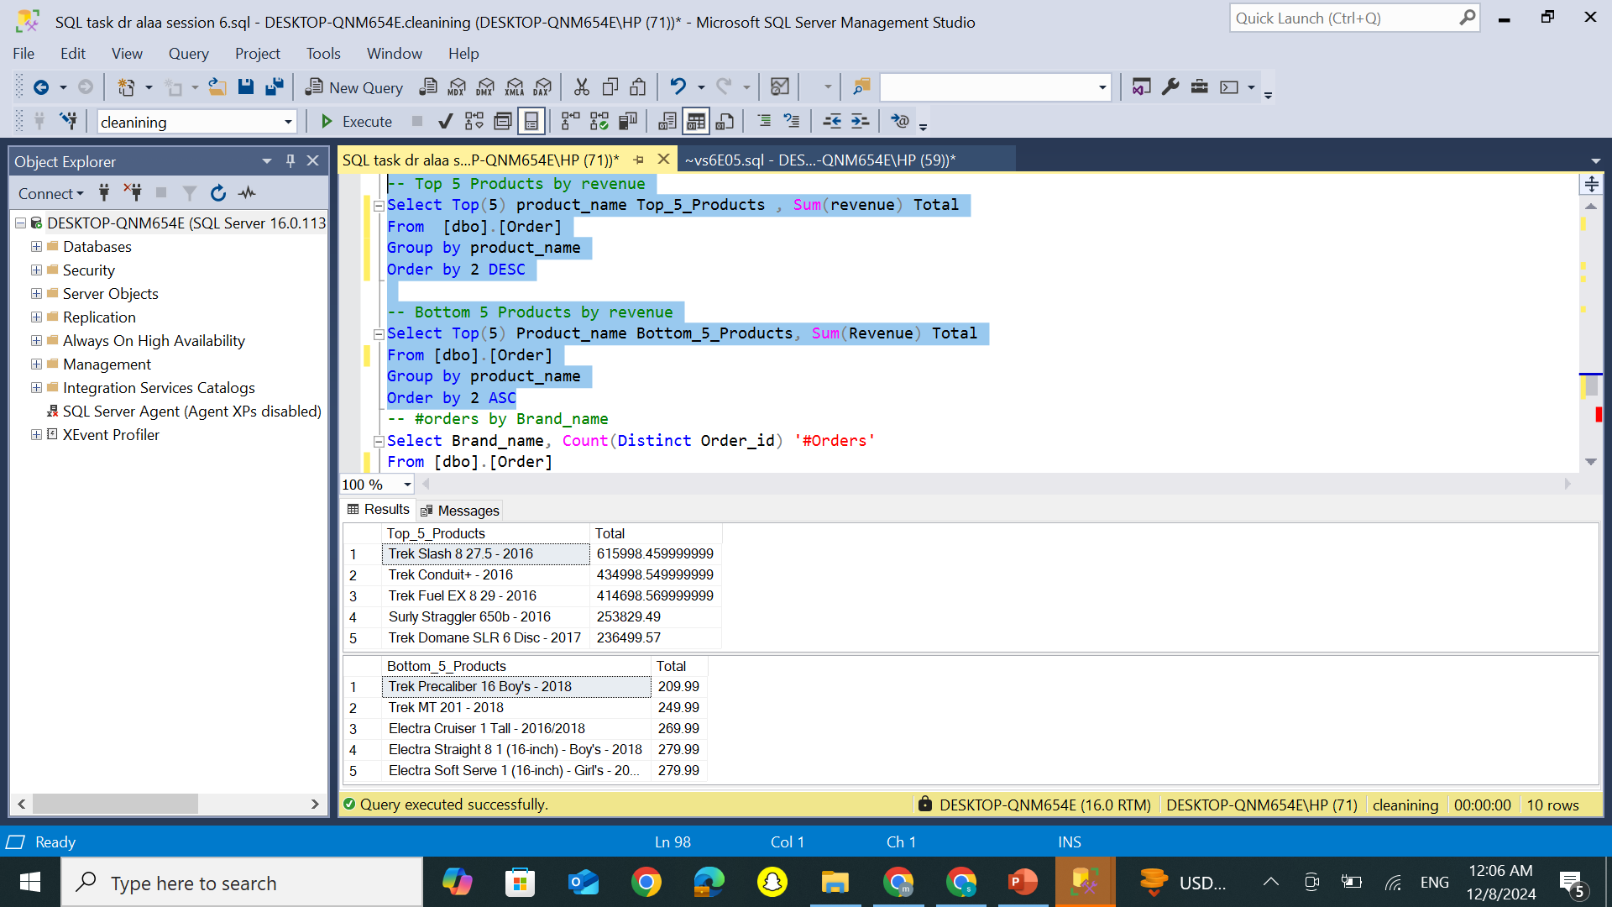
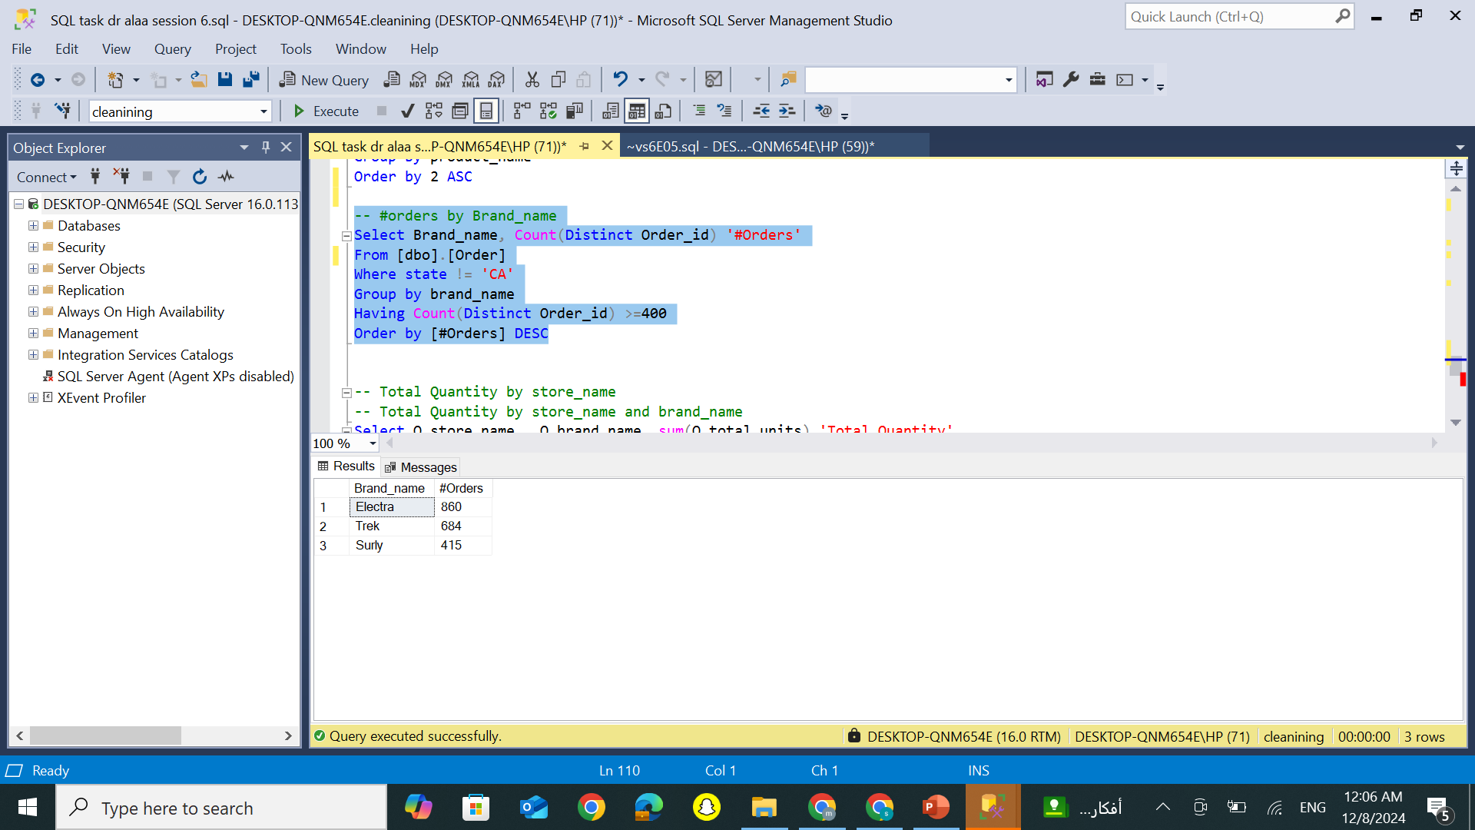
Top 5 product ,bottom 5 and no of orders in each brand

Slide 8
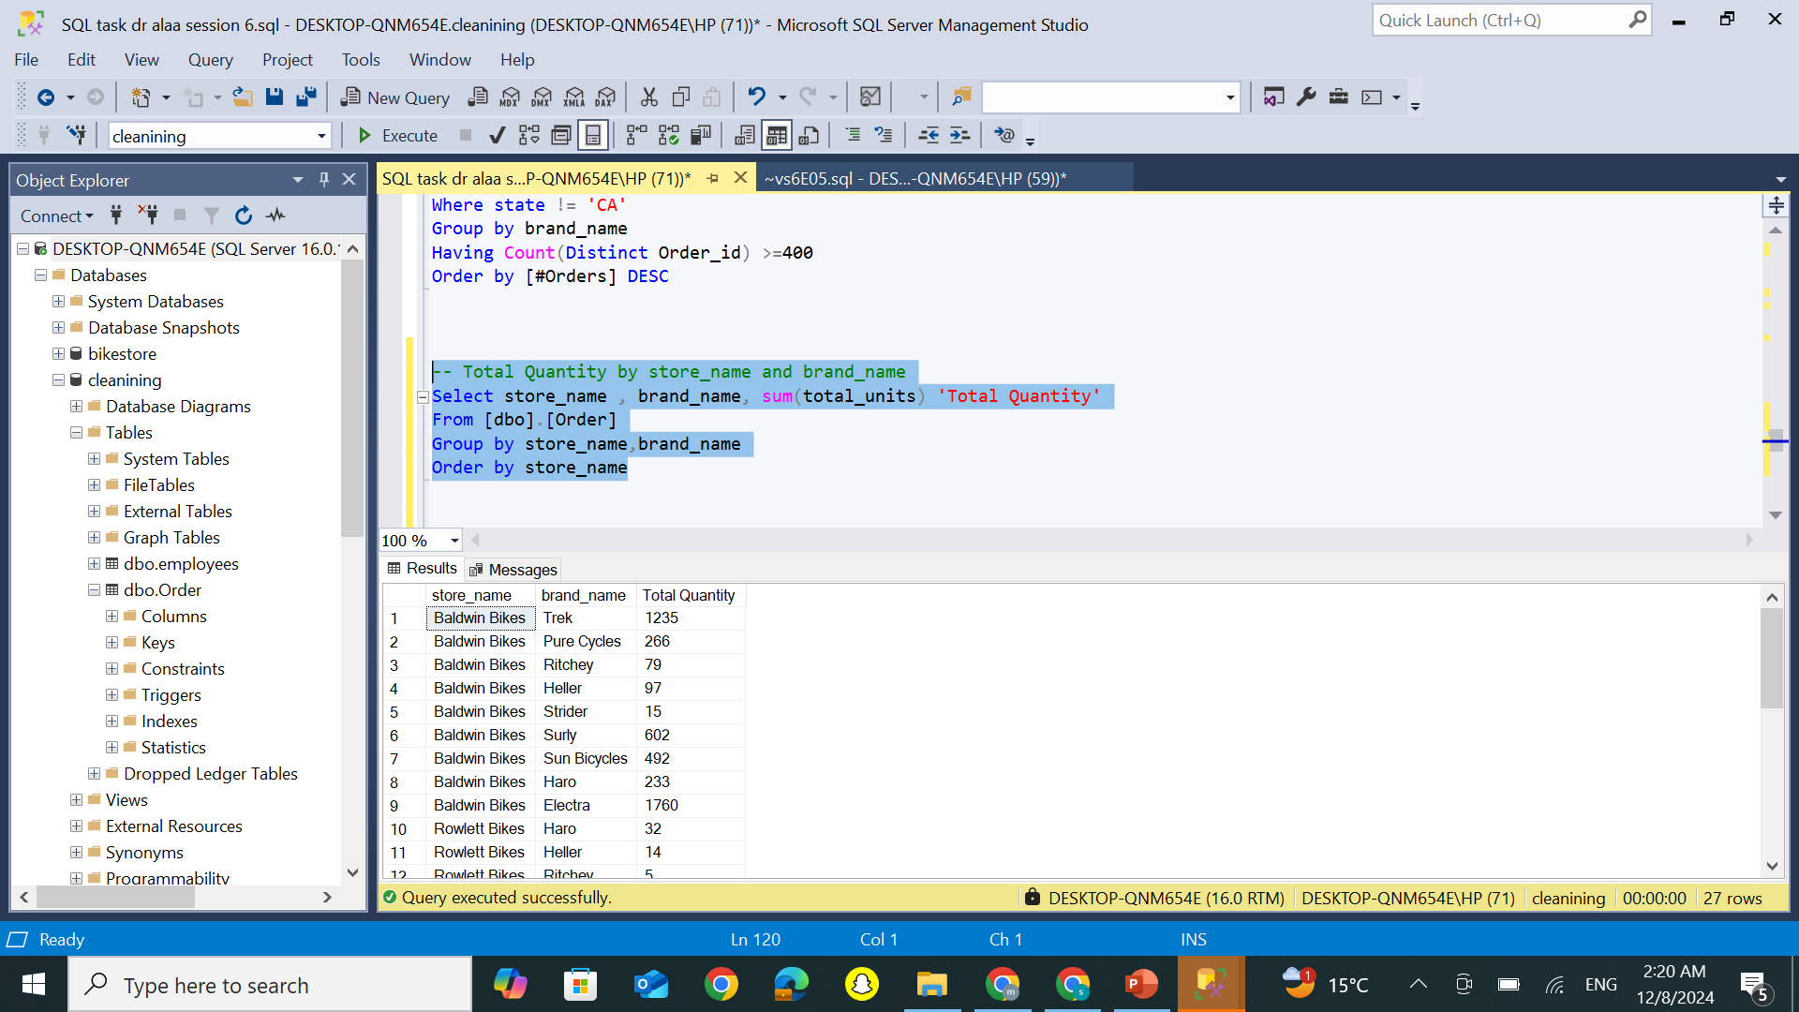
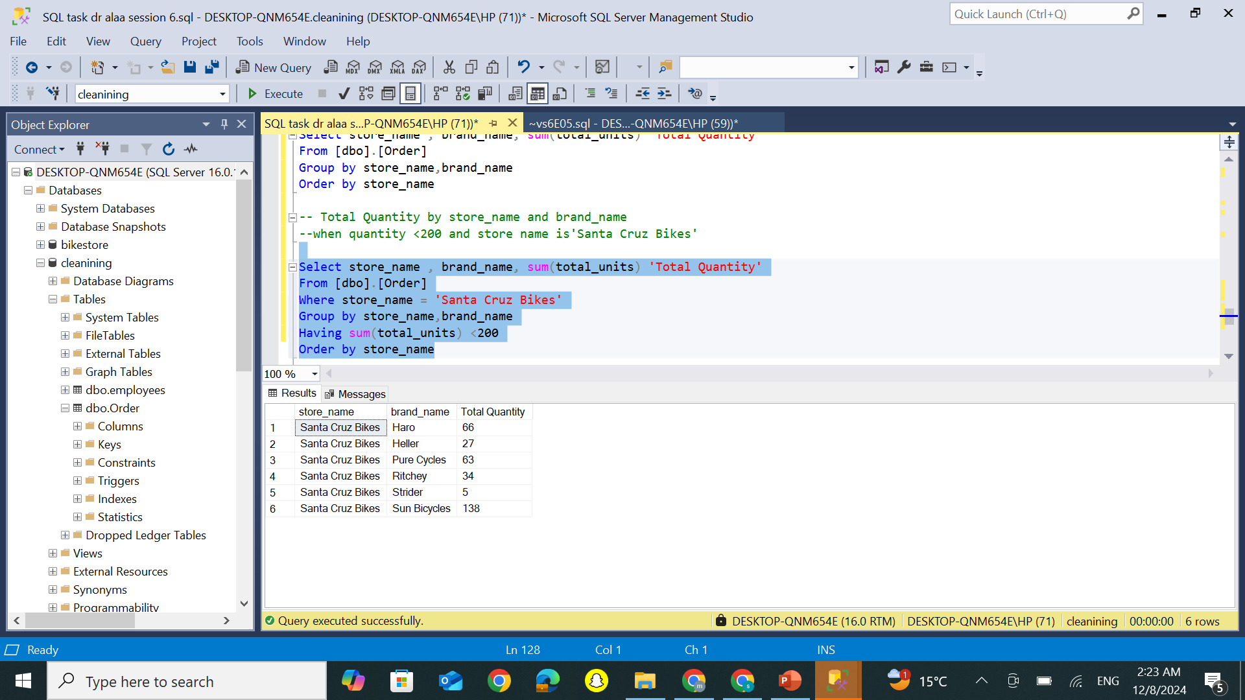
Total Quantity by Store & Brand: General Overview &Santa Cruz Bikes (Qty < 200)

Slide 9
Looking Forward to Your Feedback
Thanks

